Slide 1
Topic 3: Data Visualisation Introduction to Boxplots

Slide 2
What is a boxplot
A boxplot is a summary plot which displays the distribution of a continuous numerical variable. The boxplot highlights the
minimum
maximum
lower quartile
upper quartile
median
These can be used to easily compare observations over multiple categories.

Slide 3
What is a boxplot cont...
The box plot is made up of a box, which is limited by the lower and upper quartiles. Then a set of whiskers which show the tails of the distribution. Any observations that are outside of these limits could be thought of as outliers.

Slide 4
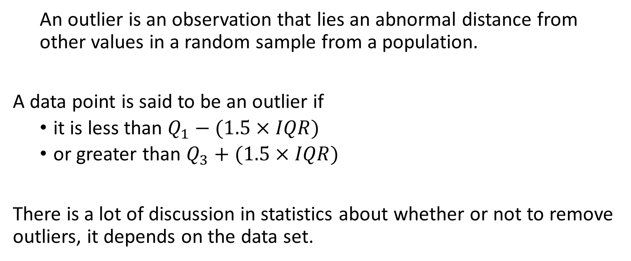
What is an outlier ?
  An outlier is an observation that lies an abnormal distance from other values in a random sample from a population.
A data point is said to be an outlier if
  it is less than $Q_{1}−(1.5×IQR)$
  or greater than $Q_{3}+(1.5×IQR)$
There is a lot of discussion in statistics about whether or not to remove outliers, it depends on the data set.

Slide 5
Create a boxplot of the iris data set
In R the function for creating a boxplot is boxplot(). You simply pass as an argument a vector of observations - commonly the vector passed in is a column of a data frame. We are going to create a boxplot for petal length in R and add a label to the y axis using the ylab command.
# require the data if you have opened R
data(iris)
# create a boxplot and add a y label
boxplot(iris$Petal.Length, ylab="Petal length (cm)")

Slide 6
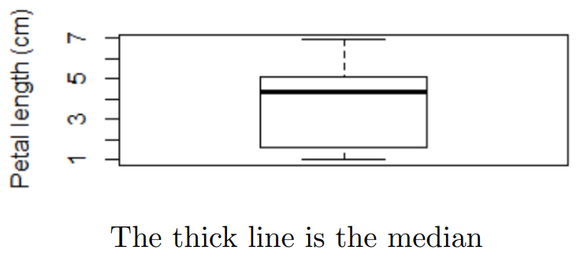
Create a boxplot of the iris data set cont...

Slide 7
Splitting a boxplot by category
We learned in the previous slides that there are three types of iris in this data set: setosa, versicolor and virginica.
It may be more informative to display a boxplot for each type of iris and its corresponding petal length.

Slide 8
Splitting a boxplot by category cont...
You can also plot boxplots by grouping variables by using the formula construct. The formula construct makes use of a.
The continuous variable is specified on the left of the formula, the categorical variables are specified on the right of the formula.
A boxplot separated by species of iris would be specified as follows
  boxplot(iris$Petal.Length ∼ iris$Species, data=iris, ylab="Petal length (cm)", xlab="Species of iris")

Slide 9
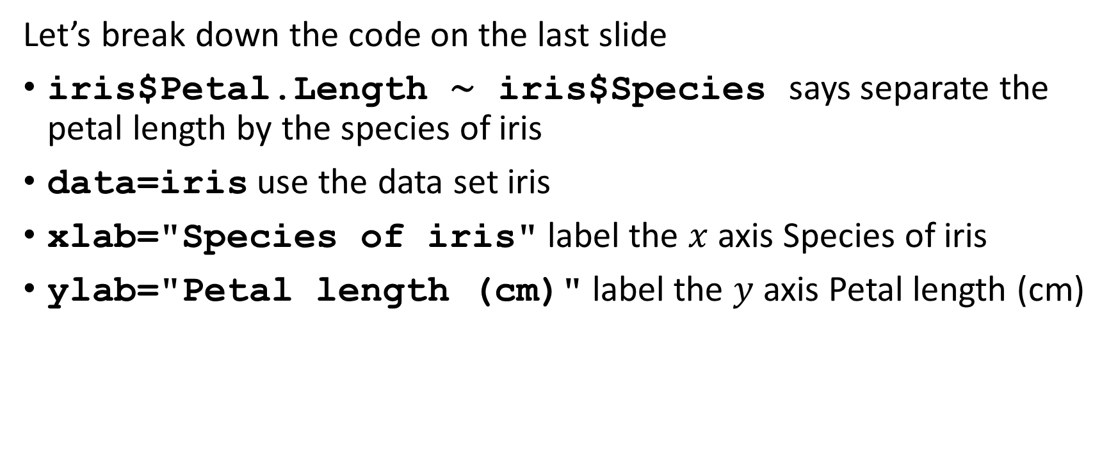
Splitting a boxplot by category cont...
Let’s break down the code on the last slide
iris$Petal.Length ∼ iris$Species says separate the petal length by the species of iris
data=iris use the data set iris
xlab="Species of iris" label the $x$ axis Species of iris
ylab="Petal length (cm)" label the $y$ axis Petal length (cm)

Slide 10
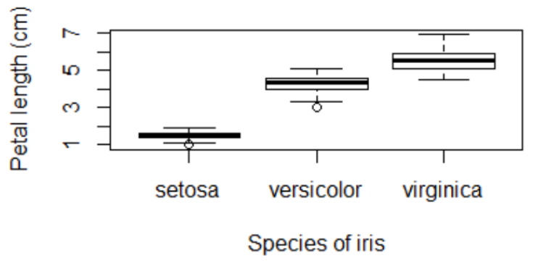
Splitting a boxplot by category cont...
Interpretation of the boxplot
The setosa and versicolor iris both contain an outlier (indicated by the circle below the whisker). Further investigation would be needed on these values.
Setosa has the smallest petal length and virginica has the highest petal length.

